Slide 1
Pipeline For Differential Expression
by
Mango

Slide 2
Introduction
Mango
Background
Project kick-off
Pipeline
Planning
Discussion
Notes:
Hello everyone, I am Marcel. I am the speaker for the Mango group.
To show you our project plan, I will start with the background and how we progressed in the first few days.
After the project kick-off, we will move on to the pipeline and our planning for the next two weeks.
At the end of the presentation there is a moment to ask questions and discuss our approach.
But first, lets move on to the background

Slide 3
Background
Mango
Project: Differential gene expression in yeast
Training dataset: published paper
Test dataset: Yeast
Notes:
We could select from two projects, differential expression and co-expression. Since we thought differential expression was interesting, we selected this project. Even though it was suggested that we find datasets from published papers, we selected the provided dataset of yeast. We selected this dataset because we are convinced our coaches validated the provided datasets. Therefore, we will use these datasets to test our final pipeline.
So what did we do in the first few days?
We started on Friday by looking at the biological aspects of the pipeline. At this point we only prior knowledge from the previous courses. Therefore, we could think broadly about the pipeline’s requirements. The final product of this discussion will be discussed later. After constructing our pipeline, we assigned priorities to each part of the pipeline using the MoSCoW approach as discussed by Harm and shown on the slide.

Slide 4
Project kickoff
Mango
Discussed:
Biological framework of the pipeline
Assign priorities to the parts of the pipeline
Draft planning
Source control and project management
Notes:
We could select from two projects, differential expression and co-expression. Since we thought differential expression was interesting, we selected this project. Even though it was suggested that we find datasets from published papers, we selected the provided dataset of yeast. We selected this dataset because we are convinced our coaches validated the provided datasets. Therefore, we will use these datasets to test our final pipeline.
So what did we do in the first few days?
We started on Friday by looking at the biological aspects of the pipeline. At this point we only prior knowledge from the previous courses. Therefore, we could think broadly about the pipeline’s requirements. The final product of this discussion will be discussed later. After constructing our pipeline, we assigned priorities to each part of the pipeline using the MoSCoW approach as discussed by Harm and shown on the slide.

Slide 5

Project-progress
Mango
MoSCoW list
MUST
Data format
Quality control
Quality improvement
Mapping
Count reads
Data normalization
Differential expression
Enrichment
GEERT – NIKOLAOS – ADITHI – MARCEL - NICK
SHOULD
Chose appropriate software for:
Mapping
Count reads
Normalization
Mapping quality
Enrichment
Bioconductor
COULD (future)
Output comparison:
Aligner: Stampy
DE: EdgeR
De novo assembly
Handle missing values
Networks assembly
Motif recognition
Notes:
Since we expect to have a tight schedule, we tried to strip-off all the unnecessary features leading to the MUST list as shown on the slide. Essential requirements of the pipeline remains. The initial dataformating, quality control, quality improvement, mapping, read counting, data normalization, DE and enrichment. In which enrichment is providing an output consisting of a basic list with genes which are enriched.
Because we want to create a feasible pipeline we should chose appropriate software, however this is not a MUST since we most likely create a pipeline using less efficient software. Moreover, you can spend a lot of time discussion which software is the best for each step. Making it a thesis project while your add it. Therefore, this is moved to the should list.
Then we have checking the quality of the mapping. Since we wish to improve the output, we included enrichment again to include GO terms and functions of the enriched genes.
Possibly add output functions for the R package bioconductor.
Then we are left with a COULD list we could make if we have time left. Due to the time pressure, we haven’t spend time on the WOULD list.
We will now continue to our proposed pipeline

Slide 6
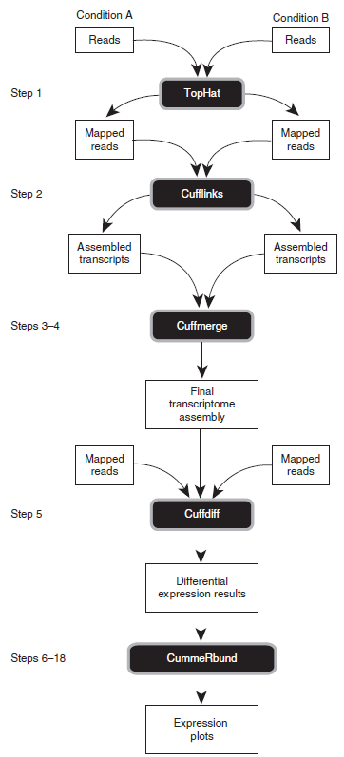
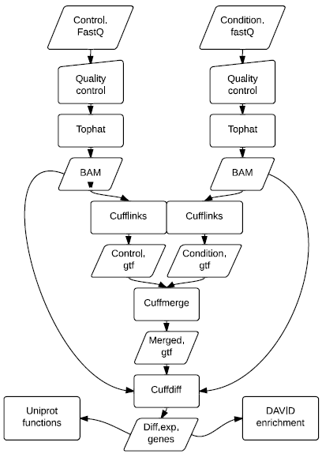
Project-kickoff – Pipeline Backbone
Mango
Cole Trapnell(et al., 2013 )
Proposed pipeline backbone
Notes:
Over the weekend we studied several articles under which “Differential gene and transcript expression analysis of RNA-seq experiments with TopHat and Cufflinks”. In this article the following protocol is proposed. However, when we compare their protocol to our proposed pipeline we found it to be missing a few steps. One such step is the quality control of the input data. After studying their protocol, we constructed the draft backbone for our pipeline, as shown on the right.
Firstly we want to illustrate that the control group and test group are processed separately in the first few steps. Moreover, we added the quality control of the input files. The alignment and mapping remains the same. The final part of the pipeline backbone is split up in a list of differentially expressed genes and two optional automated tasks for identifying enriched functions…
Now that we have our plan, it’s time to consider ways to keep track of our progress and development environments.

Slide 7
Project kickoff
Mango
Discussed:
Biological framework of the pipeline
Assign priorities to the parts of the pipeline
Draft planning
Source control and project management

Slide 8
Project-planning
Mango
Draft planning
Notes:
We took a close look at the deadlines and decided that we only have this week to create all the coding. Bassicly next week is buggfixing, report and manual writing. After this we could still add some features. Since we have the version control, we will make a tagg once we are confident with our pipeline. Which means, we create a point in the version control to which we can always return if we make errors.
To give you insight how we control our progress we have to take a look in our project time management system.

Slide 9
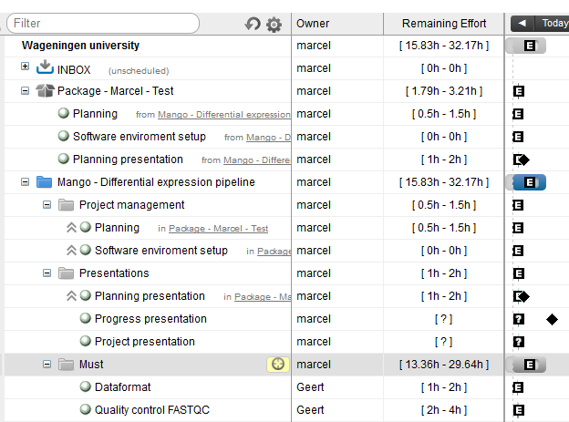
Time control
Mango
Notes:
To keep a tight track of our progress and time we created trial accounts at liquidplanner.com. Here everyone can include check lists and estimate how much time they need for their time. This gives grip on managing tasks to reach the deadlines and outline intermediate deploys.
So where are we now?

Slide 10
Project-progress
Mango
Run suggested protocol on server 15
Become familiar with the different components of the pipeline and the pipeline as a whole
Evaluate it for backbone usage
Creating a set of training files we can use to program each individual step
Compare the scientific results from the paper
Notes:
Right now we are running the suggested protocol from “Differential gene and transcript expression analysis of RNA-seq experiments with TopHat and Cufflinks”.

Slide 11
End
Mango
Now let’s go!

